Slide 1

Minor Project - III
Semester - VI
Title - Web Development & Machine Learning
Topic - GreenPact – Sustainable farming through assured contracts.
Team Members :
Dushyant Singh(112215063, CSE-A), Ramanand Kumawat(112215185, CSE - B),
Lakshay Kumawat(112215103, CSE - A), Janmesh Rajput(112215080, CSE - A),
Nikita Jaiswal(112215126, CSE - A)
1

Slide 2

Index
1
Problem Statement & Solution
2
Problem Resolution and Technology
3
Feasibility, Challenges and Risks
4
Impact & Benefits
Current Progress & Future Planning
5
2

Slide 3

Problem Statement
AIM
Our aim is to ensure fair pricing, market stability, and secure agreements between farmers and buyers through an assured contract farming system.
3

Slide 4
Solution/Idea
1
Comprehensive Digital Platform
One-stop solution for managing transactions, contracts, market trends, and crop listings (including MSPs).
2
Contract Security
Enforcing legally-bound, OTP-verified contracts with advance payments reduce fraud & payment delays. Only verified buyers and sellers can register, ensuring authenticity and trust.
3
Seller's Interface
Access to market news, demand forecasts, "E-Mandi" for crop listings and multi-buyer access to reduce dependency & improved negotiation.
4
Buyer's Interface
View crops, use "Kisan-Kart" to post requirements, and browse multi-offerings.
5
Help & Support
Chatbot assists navigation; Users can file complaints managed by the administrative system.
4

Slide 5
Problem Resolution
• Market Access: Direct link to markets bypasses intermediaries.
• Price Transparency: Real-time data aids better price negotiation.
• Predictive Insights: Market trend analytics help farmers plan crop cycles effectively reducing market fluctuation risks.
• Contractual Stability: Legally-bound contracts provide income stability.
• Market Security: Reducing financial lossesfrom companies (incase not buying produce) by providing a huge online marketplace.
5

Slide 6
What is Unique in Project?
Inclusion of FPOs(Farmer Producer Organizations)
supports consolidation aiding small-scale farmers meet large market demands, aligning with government initiatives.
Community-Based cookingContract Understanding Aid
Chatbot simplifies contracts, explains clauses, and ensures farmers are well-informed before signing agreements.
Multilingual Communication Suppor
Eliminates language barriers.
Ratings & Reviews
Enables buyers and sellers to view each other’s ratings, aiding in effective decision-making.
Long-term Contracts
Allows price negotiation based on MSP, ensuring stable income across all seasons.
6

Slide 7

Tech Stack
7

Slide 8
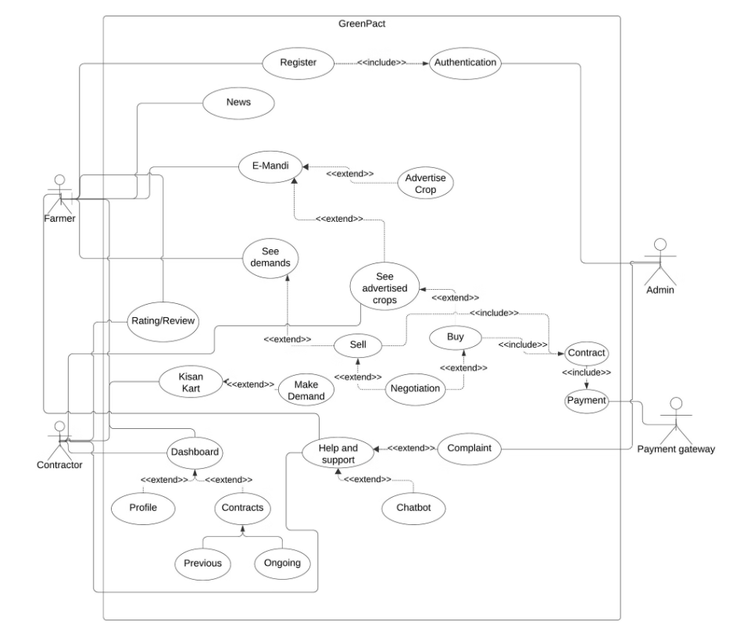
Use Case Diagram
8

Slide 9
Feasibility
1-) Technical
• Aadhaar and payment APIs simplify integration, cutting development complexity.
• Despite ease of integration, the process can still be time consuming during implementation.
2-) Financial
• Revenue comes from transaction fees, premium features, and ads, ensuring financial sustainability.
• Existing Aadhaar and payment gateways reduce the need for new infrastructure, lowering upfront costs.
• Features like Aadhar API and SMS OTP are not free, so we'll need to budget for these costs
3-) Market
• Rising demand for digital agriculture and tax benefits will boost farmer adoption of the platform.
• Widespread digital payments and platform scalability ensure strong market potential.
9

Slide 10
Challenges and Risks
• Clear contracts between farmers and contractors require standardization, transparency, and effective dispute management.
• The platform must use strong encryption and robust security to protect contracts, pricing, and payment details.
• Limited or unreliable internet in rural areas can hinder platformuse.
10

Slide 11
Impact
• Income Stability: MSP has increased farmers income by 30-35% for certain crops.
• Transaction Transparency: 25-30% of farm produce is sold through organized channels. This platform will increase that percentage.
• Market Insight: Offers real-time market trends to guide farmers on planting and selling decisions.
• Efficient Selling: Simplifies crop advertising and selling for quicker and more effective transactions
• Enhanced Bargaining: Improves negotiation power through direct buyer engagement.
• Financial Planning: Enables long-term contracts, potentially boosting farmer incomes 10-15% through expanded access to contract farming arrangements.
11

Slide 12
Benefits
1-) Social Benefits
• Farmer Empowerment: 86% of Indian farmers are small and marginal, often lacking direct market access.
• Multilingual Communication: A multilingual platform fosters inclusivity and collaboration among diverse farming communities.
• Knowledge Sharing: 22 million farmers are using agri-tech platforms. This number can grow with integrated chat services.
2-) Economic Benefits
• Informed Production: Price volatility can cause up to 30% income swings for farmers yearly. Real-time market trends can help reduce this.
3-) Environmental Benefits
• Resource Efficiency: Market and weather insights help manage water, soil, and fertilizers efficiently.
• Consolidated Farming: FPO-driven practices promote eco-friendly land and resource use.
12

Slide 13
Current Progress
Title discussion and it's research work.
Proposed Solution
Knowledge and requirements gathering.
Use-case diagram, flow chart and database design prepared.
User authentication and authorization done.
13

Slide 14
Future Planning
Setting up contract.
Implement functionality using backend and databases.
Testing
Deployment
14

Slide 15
Reference
• Chand, Ramesh. "Doubling Farmers' Income Rationale, Srategy, Prospects and Action Plan." (2017).
• Reddy, A. Amarender. "Electronic national agricultural markets." Current Science 115.5 (2018): 826-837.
• Gulati, Ashok, Ranjana Roy, and Shweta Saini. Revitalizing Indian agriculture and boosting farmer incomes.
Springer Nature, 2021.
• Beniwal, Anubhav, and Aditi Mathur. "Rajasthan's Agricultural Innovation Landscape: An Overview of Start ups and Trends." Asian J. Agric. Ext. Econ. Soc 41.4 (2023): 157-168.
• Barik, Prasenjit. "A critical analysis of India's Contract Farming Act 2020." Agricultural Economics Research
Review 34.conf (2021): 165-174.
15

Slide 16
Reference
• What has the Govt offered protesting farmers from Punjab? The proposed new formula is for NCCF, NAFED, and CCI to buy at a contracted MSP for five years. How will this arrangement work, and what have the farmers said?
16

Slide 17
Thank You
17

